Slide 1
CT Project Weekly Status Report
Jack Xu, Jenny Jiang Jun 26, 2020

Slide 2
Plan for this week
Learn Google functions and work on the server side
Implement a demo system to allows interaction between two testing devices
Revise UIUX:
Work with server side and see any changes should be made

Slide 3
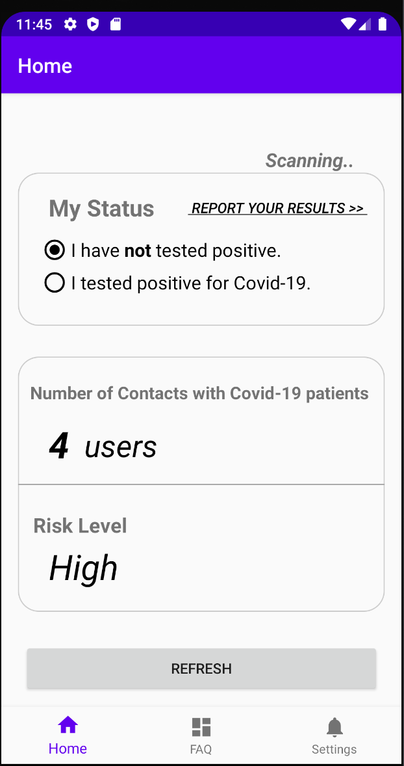
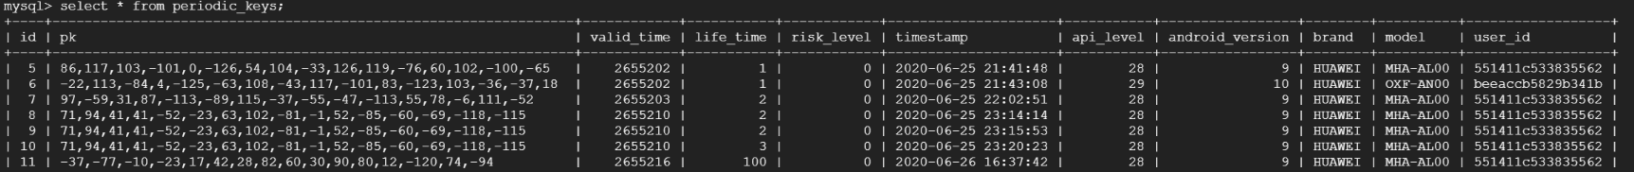
Our work this week
Demo App Implementation
Implemented server side based on Google Cloud
Implemented client side based on UIUX prototype designs
Made the connection between device and server
Made CS kit work throughout the process
Video Demo – Client side
Screenshot - Server side

Slide 4
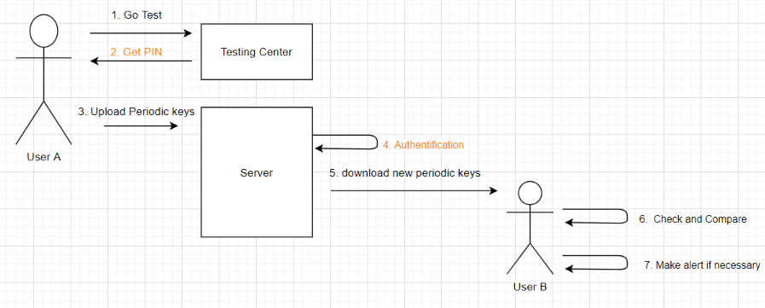
System Summary
Note: Colored part has not been implemented yet

Slide 5
Plans for next week
Test the current application and fix potential bugs
Add the authentication part
Look into the possibility of including Push kit
Fix and improve UI
Analyze Germany Corona-Warn-App UIUX
Design dashboard to analyze data

